Slide 1



Fourth Grade Elementary Curriculum Essentials
A quick glance at the standards/outcomes you should be seeing in your classrooms this month. All grade level Standards are expected to be taught;
however, the essential standards need to be mastered/secured prior to the end of the school year.
ELA
Unit 4 Pacing Guide
Math
Reading Foundational Skills:
Reading - Literature:
RF.4.4a: Read grade-level text with purpose and understanding.
RF.4.4b: Read grade-level prose and poetry orally with accuracy, appropriate rate, and expression on successive readings.
RF.4.4c: Use context to confirm or self-correct word recognition and understanding, rereading, as necessary.
RL.4.1: Refer to details and examples in a text when explaining what the text says explicitly and when drawing inferences from the text.
RL.4.10: By the end of the year, read and comprehend literature, including stories, dramas, and poetry, in the grades 4-5 text complexity band proficiently, with scaffolding as needed at the high end of the range.
Reading – Informational Text:
Speaking & Listening:
SL.4.1: Engage effectively in a range of collaborative discussions (one-on-one, in groups, and teacher-led) with diverse partners on grade 4 topics and texts, building on others' ideas and expressing their own clearly.
No essential standards this month.
Language:
L.4.1c Use modal auxiliaries to convey various conditions.
L.4.1g: Correctly use frequently confused words.
L.4.4a: Use context as a clue to the meaning of a word or phrase.
Writing:
W.4.5: With guidance and support from peers and adults, develop and strengthen writing as needed by planning, revising, and editing.
W.4.8 Recall relevant information from experiences or gather relevant information from print and digital sources; take notes and categorize information and provide a list of sources.

Slide 2
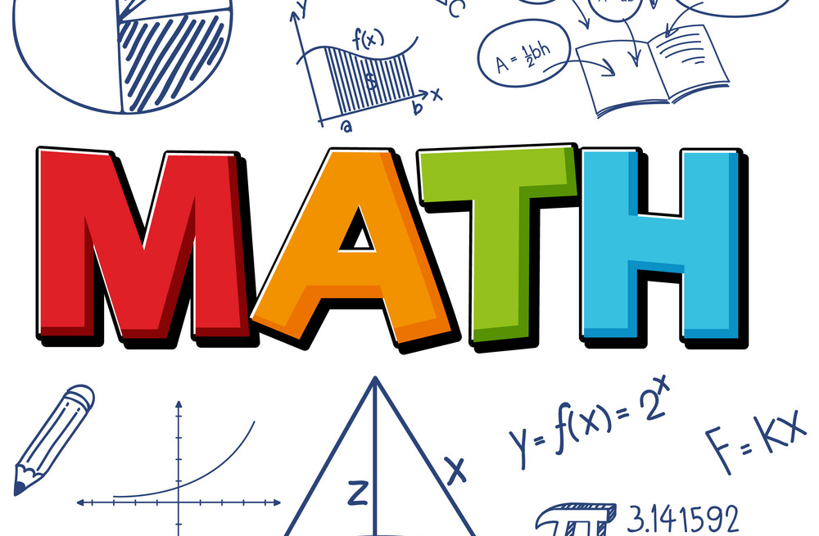
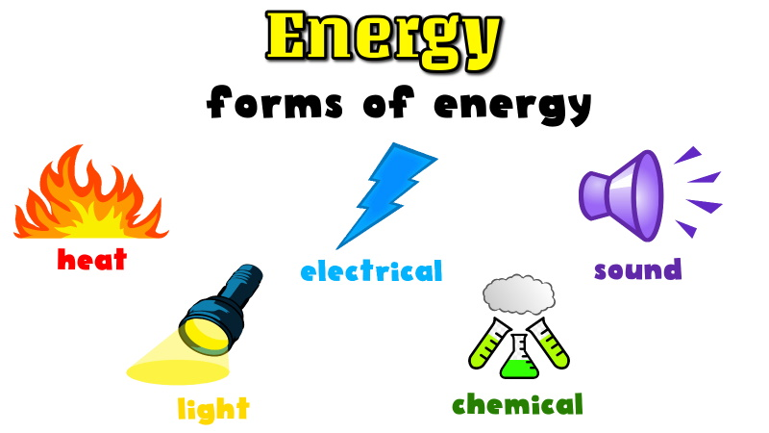
Math
Integrated Strategies
Topic 5: Use Strategies and Properties to Divide by 1-Digit Numbers 10 Lessons Topic 6 : Use Operations With Whole Numbers to Solve Problems 5 Lessons
Engagement:
Blended Learning:
Language ELLevation:
Role Play
Students assume the role of a person or act out a given situation. These can be performed by individual students, in pairs, or in groups.
Formative Assessment
Students use digital tools like Nearpod, Quizizz, Padlet, etc. to take short quizzes or complete exit tickets, providing teachers with immediate data.
Writing Windows Students will view an image related to the content topic, brainstorm related words and phrases with a peer, and write a descriptive phrase, sentence, or paragraph about the image.
Critical Content Area 1:
Numbers & Operations in Base Ten
Students generalize their understanding of place value to 1,000,000, understanding the relative sizes of numbers in each place. (NBT.1; NBT.2)
They apply their understanding of models for multiplication (equal-sized groups, arrays, area models), place value, and properties of operations, in particular the distributive property, as they develop, discuss, and use efficient, accurate, and generalizable methods to compute products of multi-digit whole numbers. Depending on the numbers and the context, they select and accurately apply appropriate methods to estimate or mentally calculate products. They develop fluency with efficient procedures for multiplying whole numbers; understand and explain why the procedures work based on place value and properties of operations; and use them to solve problems. (NBT.5)
Students apply their understanding of models for division, place value, properties of operations, and the relationship of division to multiplication as they develop, discuss, and use efficient, accurate, and generalizable procedures to find quotients involving multi-digit dividends. They select and accurately apply appropriate methods to estimate and mentally calculate quotients, and interpret remainders based upon the context. (NBT.6)
Science
Physical Science – Energy
(November 13 – March 15)
Investigation 1 & 2*: *4-PS3–2: Make observations to provide evidence that energy can be transferred from place to place by sound, light, heat, and electric currents. 4-PS3–4: Apply scientific ideas to design, test, and refine a device that converts energy from one form to another. 3-5-ETS1: Engineering Design
Envision Pacing Framework
Topic 5: Curriculum Guide
Topic 6: Curriculum Guide
Foss Pacing Guide

